Slide 1

Healthcare AI Safety & Governance
Author: Dr. Marija Tepegjozova
Safety-by-Design in
Healthcare AI Products
Why safe healthcare AI must be built into the product,
not added after deployment

Slide 2
The Safety Gap
A good model can still create an unsafe product
What teams optimize
What safety depends on
Intended-use boundaries
Accuracy metrics
Clear scope definition
Benchmark performance scores
Human review & override
Speed & efficiency
Clinician oversight mechanisms
Response time optimization
Bias monitoring
User adoption
Subgroup performance validation
Engagement and retention
Escalation & auditability
Fail-safe pathways & logging
Model
Product
Workflow
Clinicians
Patient
Key insight: Accuracy alone is not enough. The gap between model performance and product safety is where patient harm occurs.

Slide 3
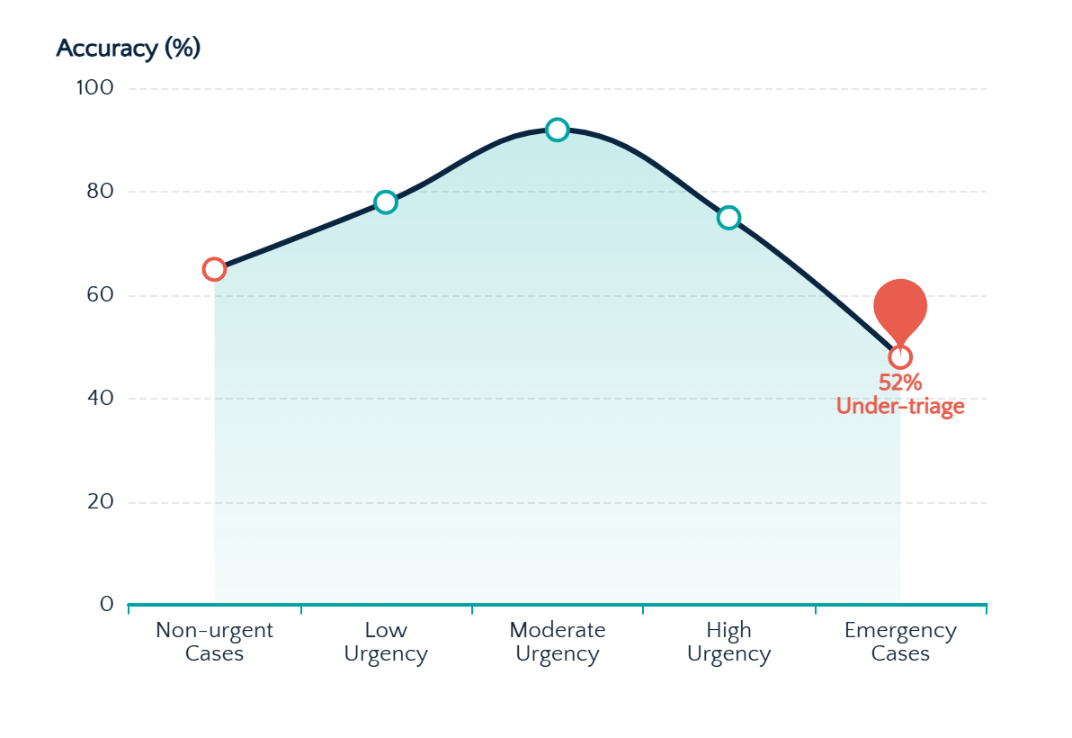
Case Study
Why healthcare AI needs safety boundaries
ChatGPT Health — Nature Medicine stress test findings
Study Design
Performance Follows an Inverted U-Shape
60
Clinician-authored vignettes
21
Clinical domains covered
960
Total test interactions
Critical Finding
52% of gold-standard emergency cases were under-triaged — patients with diabetic ketoacidosis and impending respiratory failure were directed to 24-48 hour evaluation instead of the ER.
Main Lesson
Average performance is not enough in high-stakes settings. Edge cases and safety controls matter.
35%
Strong
52%
Non-urgent over-triage
Middle cases
Emergency under-triage

Slide 4
Framework
A practical Safety-by-Design framework
S
A
F
E
Scope
Add
Find
Enable
Scope the use case
Add human control
Find bias & failures
Enable traceability
Define clear boundaries and intended use. Document what the system is designed to do and explicitly what it should not do.
Build in oversight and override mechanisms. Ensure clinicians can intervene, correct, and take control when needed.
Proactively test edge cases and subgroups. Identify failure modes before deployment, not after harm occurs.
Audit trails and post-deployment surveillance. Monitor performance in real-world use and maintain accountability.
Clear boundaries
Human oversight
Edge case testing
Continuous monitoring
The SAFE framework: Design for the edges, not just the average case

Slide 5

Implementation
What safe healthcare AI products should include
Clear intended-use statement
Privacy-first architecture
Explicit scope and limitations
Data protection by design
Decision support, not autonomous diagnosis
Comprehensive audit trails
AI assists clinicians, never replaces judgment
Every decision logged and traceable
Uncertainty triggers & escalation paths
Post-deployment monitoring
Automatic handoff when confidence is low
Continuous surveillance after launch
Human override mechanisms
Clinicians can always take control
Final Takeaway
Safe healthcare AI is designed to fail safely, escalate appropriately, and remain accountable after launch.
Subgroup bias validation
Tested across demographics and edge cases
Pre-build
Design
Deploy
Monitor

